Slide 1
Final PPT
STEGANOGRAPHY

Slide 2
What is steganography ?
Steganography is the technique of hiding secret data within an ordinary, non-secret, file or message in order to avoid detection; the secret data is then extracted at its destination. The use of steganography can be combined with encryption as an extra step for hiding or protecting data.

Slide 3
Why steganography ?
The purpose of steganography is covert communication—to hide the existence of a message from a third party.
Steganography can be a way which makes it possible to send news and information without being censored and without the fear of the messages being intercepted and traced back to us.

Slide 4
Types
Text Steganography
Image Steganography
Video Steganography
Audio Steganography
Network Steganography

Slide 5
Image steganography
Hiding the data by taking the cover object as the image is known as image steganography. In digital steganography, images are widely used cover source because there are a huge number of bits present in the digital representation of an image.

Slide 6
How this type can work ?
There are a lot of ways to hide information inside an image. Common approaches include:
Least Significant Bit Insertion
Masking and Filtering
Redundant Pattern Encoding
Encrypt and Scatter
Coding and Cosine Transformation

Slide 7
LEAST SIGNIficant bit method we use
Least Significant Bit steganography is one such technique in which least significant bit of pixels of the image is replaced with data bits. This approach has the advantage that it is simplest one to understand, easy to implement and results in stego-images that contain embedded data as hidden.

Slide 8
Implementation details
The User chooses an image, the image data is then normalized, meaning that each RGB value is decremented by one if it is not even. This is done for every pixel in the image.
Next the message is converted to a binary representation, 8 Bits per character of the message. This binary representation is then applied to the normalized image, 3 Bit per pixel. This concludes, that the maximal length of a message hidden in an image is:
Image Width * Image Height * 3
FORMULA = ----------------------------------------------
8

Slide 9
Working steps
ENCODING PROCESS
DECODING PROCESS

Slide 10
Encoding process
Encoding is performed over the secret image/message before embedding and each bit of code of secret image/message is embedded inside the cover image by altering the least significant bit (LSB) of each of the pixel's intensities of cover image.
After selecting the image it converts the desired text into ASCII value ( through in built function ) and ASCII value into Binary code .

Slide 11
Decoding process
Decoding or decryption is getting the secret information from image file. To send a message, a source text, an image in which the text should be embedded.
Through FOR loop we checked every 4th bit that our text value is present or not and if got the value it will print the binary number and if the value is not present it will print null value in pixel .

Slide 12
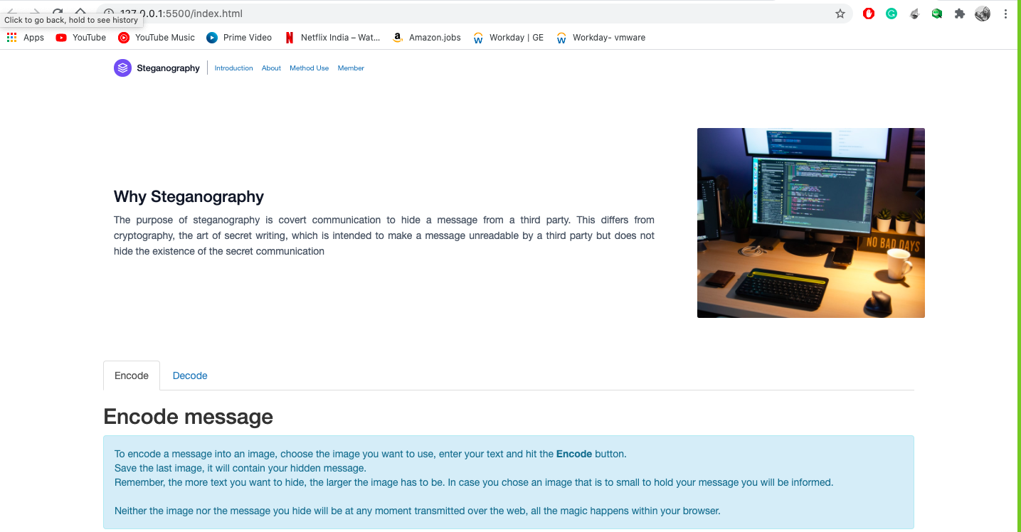
Output validation

Slide 13
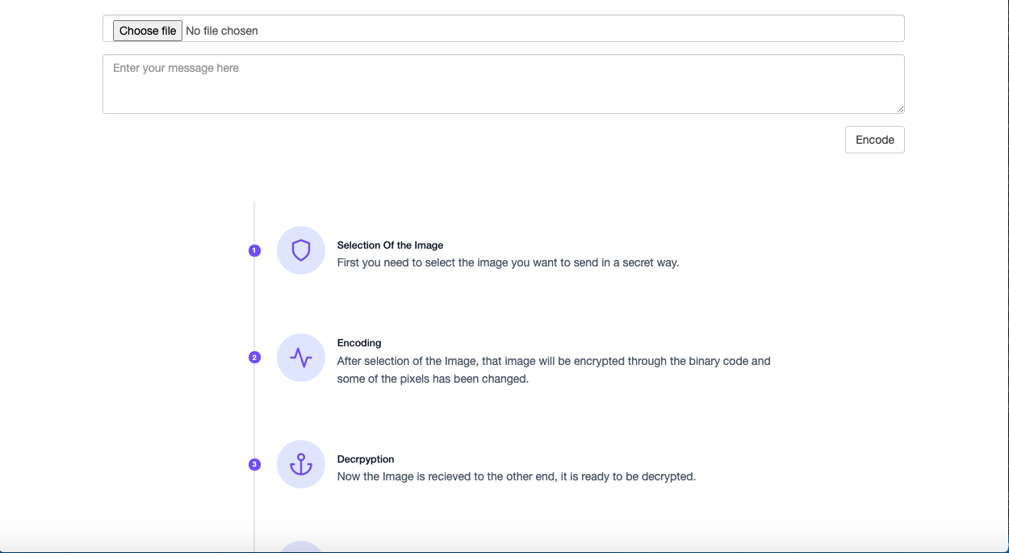
interface

Slide 14
Applications
The most common application is watermarking . Watermarking" is the process of hiding digital information in a carrier signal; the hidden information should, but does not need to, contain a relation to the carrier signal
In cybersecurity systems .

Slide 15
Additional layers of security
As mentioned before, steganography is no means of encryption, just a way to hide data from plain sight. But one could, for example, hide a pgp encrypted message inside an image. So even if the image did not go unnoticed, the message would still only be readable by the person it was addressed to.

Slide 16
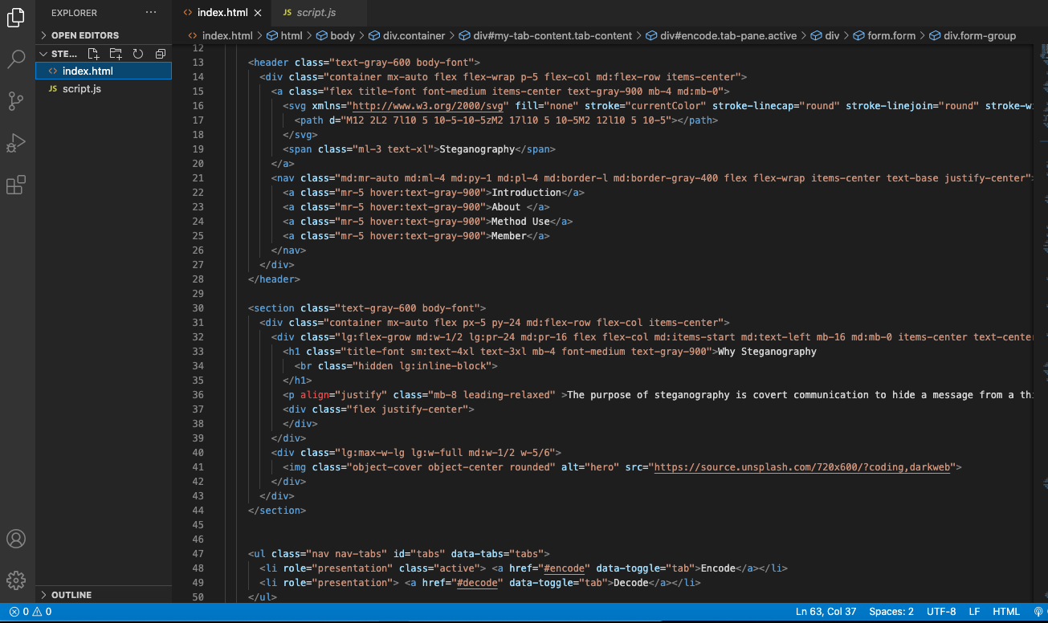
Front end implementation

Slide 17
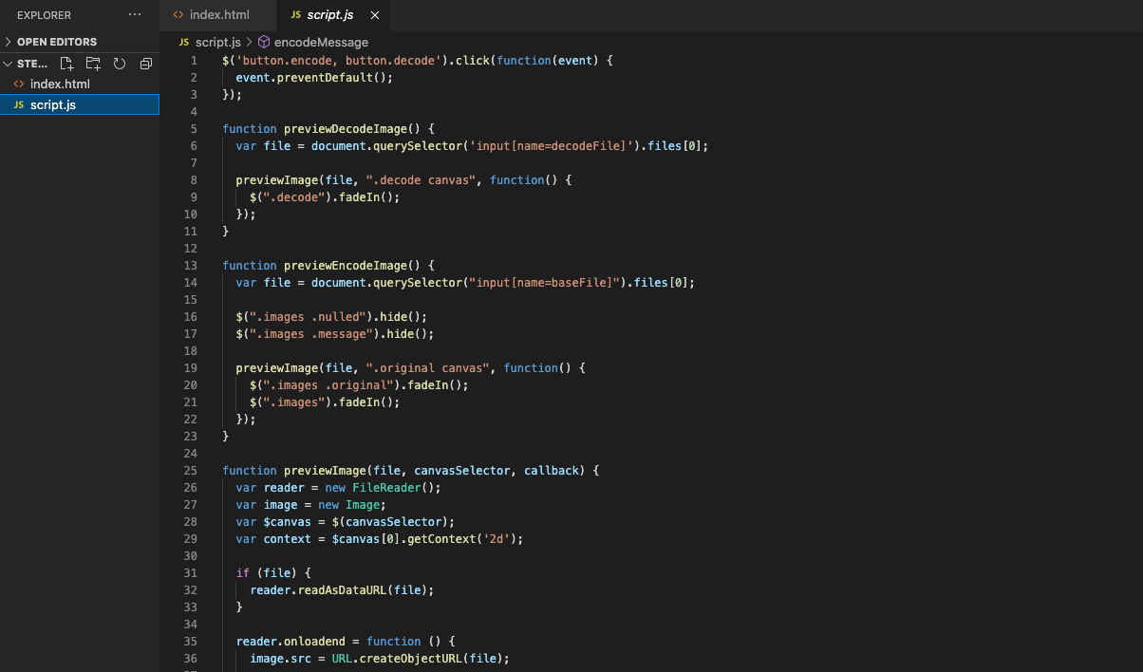
Backend implementation

Slide 18
BIBLiOGRAPhy
Wikipedia - The Free Encyclopedia. Steganography.
Wikipedia - The Free Encyclopedia. Stegotext.
Plunt. Steganography (hide and seek) Tutorial.

